Slide 1
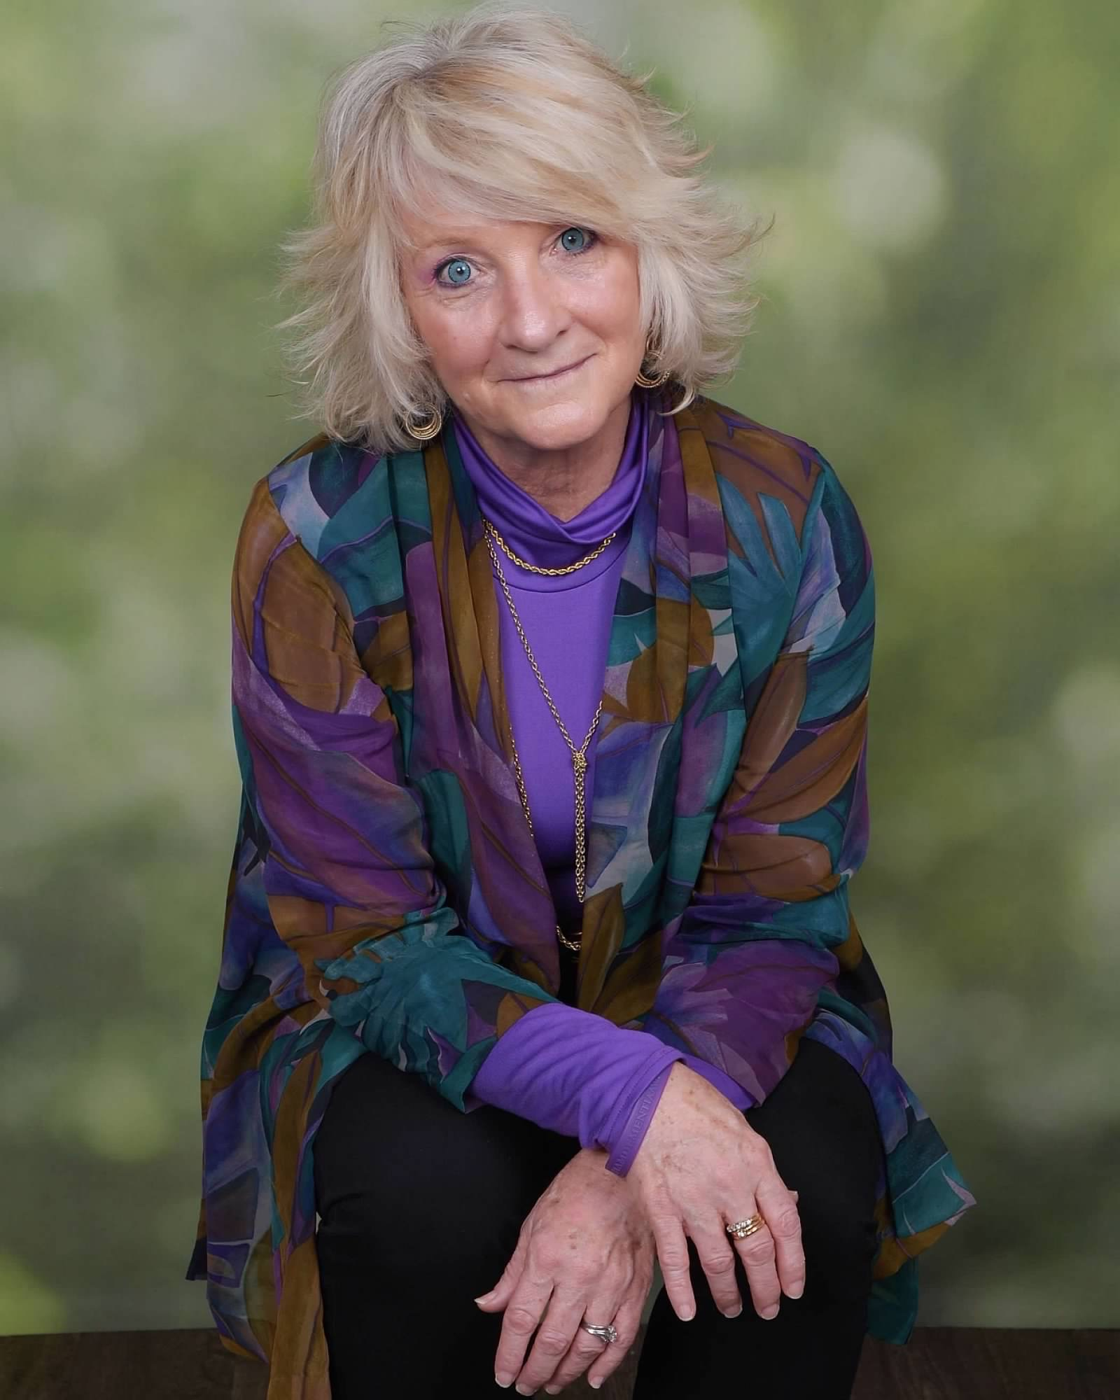
Compassionate Communication- Becoming Dementia-Aware
Laura Wayman,
The Dementia Whisperer

Slide 2
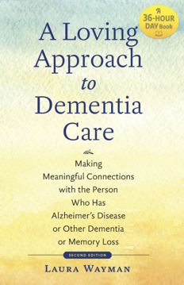
Ms. Wayman is a Best-Selling Author, Dementia Care Expert, Trainer and Consultant, raising dementia-awareness with many organizations and entire communities across the United States and around the world.

Slide 3
What Does it Mean to Become “Dementia-Aware”?
A Dementia-Aware Individual:
Practices Proven Strategies to Grow a Deeper Understanding of Dementia
Breaks Old Habits and Learns New and Effective Communication Techniques
Utilizes Fundamental Tools to Better Understand the World Through the Eyes of Those With Dementia Symptoms

Slide 4
The Ultimate Toll… The Story of Peggy
If only we could of reached Peggy before it was too late-but she is our gentle teacher, hero and example of the selflessness often present in the hearts of caregivers.
68% of the time, especially if the caregiver is a same age spouse, they get sick and often pass on before the loved one they are caring for!
And Peggy’s story hits home…right into my heart!

Slide 5
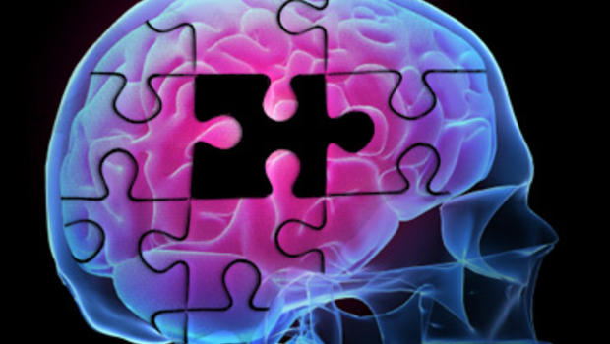
What is “Dementia”??
Dementia is NOT a diagnosis
Dementia is NOT all about memory loss
Dementia is a list of symptoms
Must have a cause

Slide 6
There are over 100 Causes!!
Brain Illness/Disease
Brain Injury/Trauma
Ongoing Infections/Medications

Slide 7
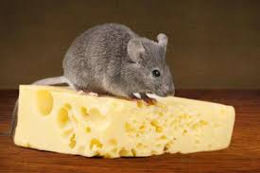
There is nothing wrong with me…

Slide 8
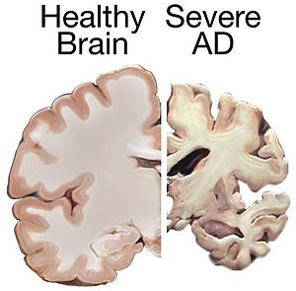
Learned Brain Function vs. Basic Brain Function

Slide 9
Basic Brain Functions; Breathing Consciousness Heartbeat Swallowing Hearing Vision Movement
Learned Brain Functions;
Balance
Coordination
Speech/Language
Intelligence
Processing

Slide 10
Babies come to us with feelings and emotions
The feelings and emotions remain!

Slide 11
Learning to “think” for someone who has a “broken thinker”!
No Questions
No Options
Instead use:
Positive Action Statements

Slide 12
Changing your communication and care approach so that you can “think for them”
Change the following into a positive action statement:
How are you today?
Are you hungry?
Can I help you with your shower?
How are you feeling?
Why are you doing that?
What do you want to eat?
This takes practice-it is counter-intuitive to how you have always communicated with an adult!!
Take a deep breath, smile, slow down and relax, join their feelings, -pause and give them time to process, then use a positive action statements…

Slide 13
Join their feelings-(this will help them to trust you and not feel so defensive)
You may often get a negative response when you approach someone with a question such as: “Are you hungry?”, What would you like for dinner?”, Would you like to come listen to the music?”, “Can I help you with that?”, Take a deep breath, smile, slow down and relax, join their feelings, -pause and give them time to process, then use the following positive action statements (or a combination of these examples below):
“It has been a while since we ate, I bet you are hungry. Come sit and have dinner with me.”
“I always enjoy breakfast/lunch/dinner more when we eat together.”
“I made your favorite fried chicken, let’s eat.”
“I always enjoy the music when we go together.”
“All of your friends are listening to the music, they are waiting for you to come, too.”
“I always enjoy helping you.”
Keep it simple, clear and to the point. And be sure and utilize actions, hold out your hand, bring them their walker, take their arm…show and tell-not just words.

Slide 14
Be careful what you say and do…
Maya angelou says:
Making this quote “Dementia-aware”:
Instead of greeting someone with the usual question “How are you?” or “What is your name?”
Use the following positive action greetings:
“It is so nice to meet you.”
“You have such a nice smile.”
“I enjoy spending time with you.”
“That color looks so good on you.”
“People will forget what you said…
People will forget what you did…
But they will never forget how you make them feel”.
Someone with dementia symptoms may not process what you say…
Someone with dementia symptoms may not process what you do…
But what you say and do will always make them feel!

Slide 15
Basic Dementia-Aware Strategies to Keep in Mind:
NO QUESTIONS OR OPTIONS
JOIN THEIR FEELINGS
USE POSITIVE ACTION STATEMENTS
STAY CALM, CONFIDENT, PATIENT AND PRESENT IN THE MOMENT
KNOW THAT YOU CANNOT STOP, FIX OR CHANGE THE SYMPTOMS, BEHAVIORS OR DECLINE
HELP THEM TO FEEL LOVED, SAFE, SECURE AND VALUED

Slide 16
Questions? Thoughts? Comments?
How can The Dementia Whisperer continue to help you become more dementia aware?
Social media information:
Email:
help@laurawayman.com
Website
www.laurawayman.com
Cell phone
916-792-7512

